Slide 1
REGISTRATION & COLLECTING DATA ON CAUSE OF DEALTH IN HEALTH SECTOR
Hoang Thanh Huong MD,MPH
DPF- Ministy of Health, Vietnam

Slide 2
OUTLINE OF PRESENTATION
Role of death statistics and CoD
Death register & reporting system on death, CoD
Recommendations
1
2
3

Slide 3









ROLE OF DEATH STATISTICS AND COD
Measuring health status
Provide evidece for planning & policy making in Health sector
Impact assess.
on health care & protection
Assessing status of the Socio-Economic development
Implementing the National Action Programme for period of 2017-2024
Deaths information
Data on deaths, CoD play an important role

Slide 4
NETWORK OF COLLECTING DATA ON DEATH & CoD BY ROUTIN REPORT
District level
( Form 16/BCH)
Village Health Workers/PFP collaborators
MOH (DPF)
Provincial level ( Form 16/BCT)
Communal level
- Death register(A6/YTCS): name, death date, ethnicity, place of death, causes of death, physicial be attending
- Reporting form (form for death in community -10/BCX)

Slide 5
OTHERS METHOD
Maternal Mortality audit
Suveillance system for outbreak of communicable Diseases
Monitoring system of NCD
Tracking system of Injuries/Accidents

Slide 6
COLLECTING DATA ON DEATH & COD
Archivement
Shortcomings
Recommendations

Slide 7
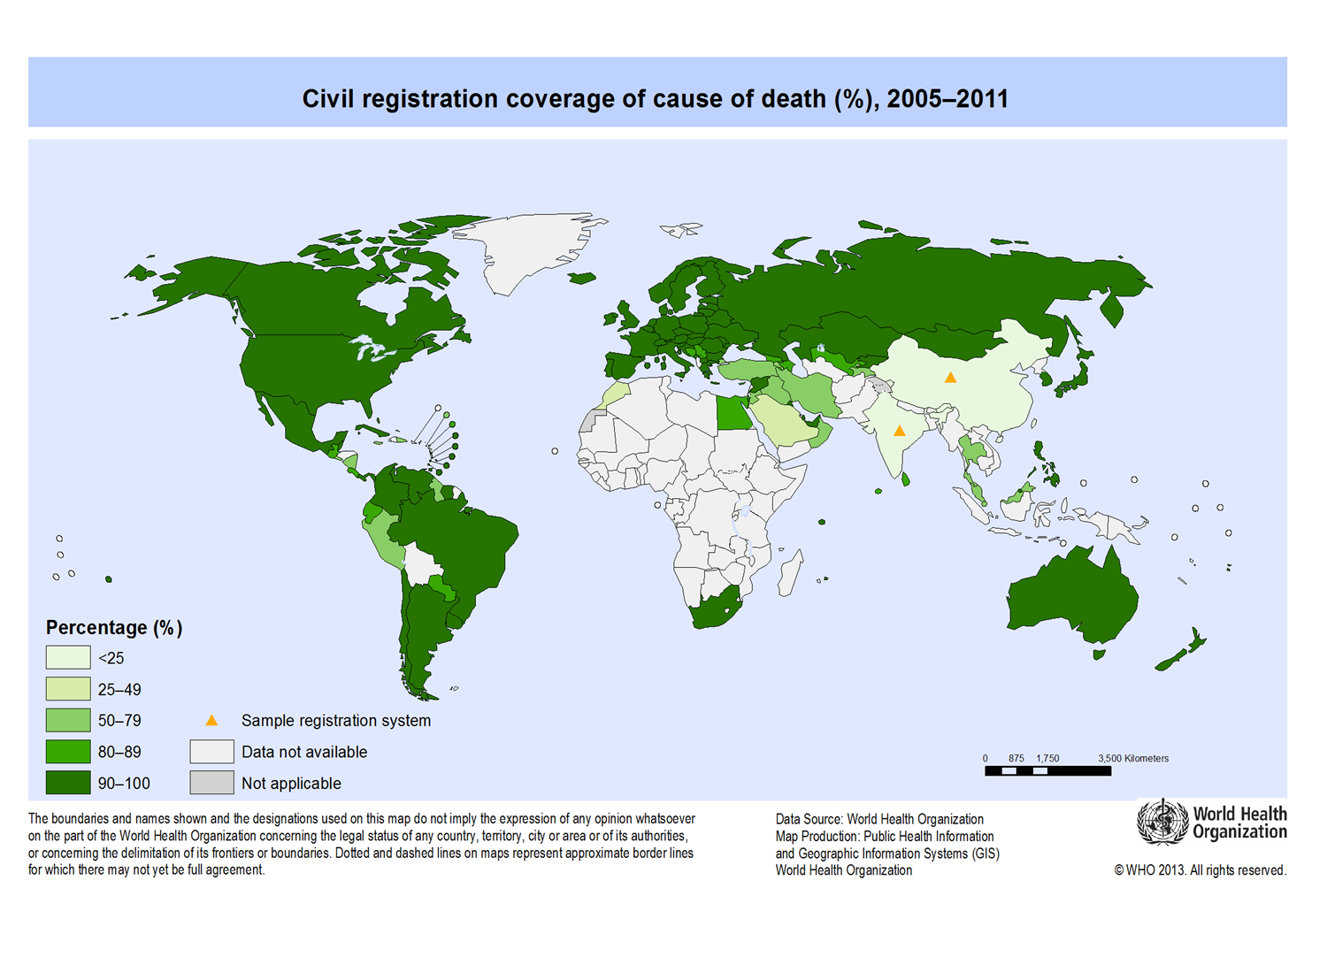

Slide 8







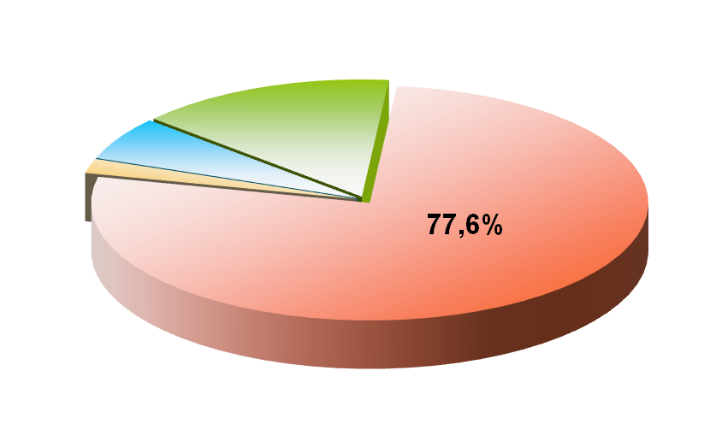
Place of death occuring
Health facilities
On the road
At home
Others
14,4%

Slide 9
THE CURRENT SITUATION OF HIS
Archivements
Civil register and reporting system has been implemented nationwide.
The Ministry of Health has applied ICD 10 in hospitals.
Collecting data on deaths & cause of death is integrated with HMIS, the National Health Programs and the functional departments within the Ministry of Health.
Data dissemination on death, COD in HSYB yearly

Slide 10
THE CURRENT SITUATION OF HIS
Shortcomings
Dead cases in health facilities accounted for 14% of total deaths, the dead case in community were not recorded in the logbook in CHC.
In hospital, doctors typically determine underlying CoD as direct CoD

Slide 11
THE CURRENT SITUATION OF HIS
Shortcomings
The ICD coding practices for causes of death has been implemented in hospital.
The WHO’s principles and forms for determining causes of deaths are not applied yet.
No documents defined the ICD coding of COD from management agencies
The training on ICD coding has not been paid attention.
Most of the hospitals are check ICD codes manually on paper, some hospitals have to download software by themselves for serving coding ICD

Slide 12
The causes of shortcomings
Lack of coordination and sharing of information among units in the health sector and between the health sector and ministries
The human resources of the health information system are insufficient in number, part-time and less trained in professional statistics.
No international recommendation on mortality and cause of death has been applied: using VA for mortality in the community.
Limited IT application: lack of unique code for each people, database in poor areas has no connection from many sources.

Slide 13
RECOMMENDATIONS
Collaborate with the Ministry of Justice to complete the legal documents on CRVS.
To study the model of collecting mortality in the health sector
Develop a specific action plan in Health sector
Capacity building for medical staff on identify underlying COD and ICD coding practice
Applying advance IT on colleting, analyzing, transmitting and sharing data on deads, COD

Slide 14


Identify CoD & Death registration
+
Health sector provide death notification
(including COD)
Justice sector provide death certificate
Achieve objectives in National action Programme on CRVS

Slide 15

Thank you!

